Slide 1
VADODARA INSTITUTE OF ENGINEERING Institute Code : 080

Slide 2
TRANSPORTATION ENGINEERING
Name and enrollment no. :Nimkar Sagar 130800119045
Raj Jariwala 130800119087
Subject : ELEMENTS OF CIVIL ENGINEERING
Branch & Division : MECHANICAL -II
Semester : I
Academic year : 2013-14
Guide : Asst. Prof. Megha Patel

Slide 3
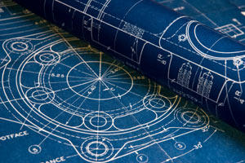
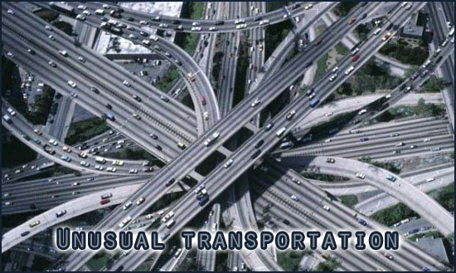
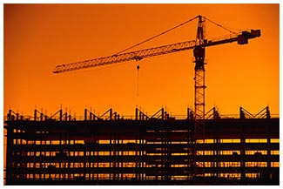
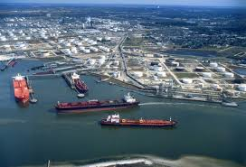
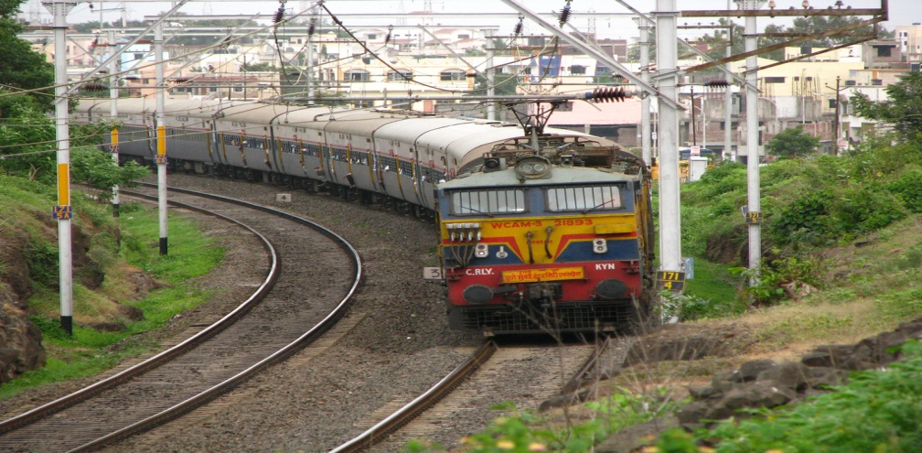
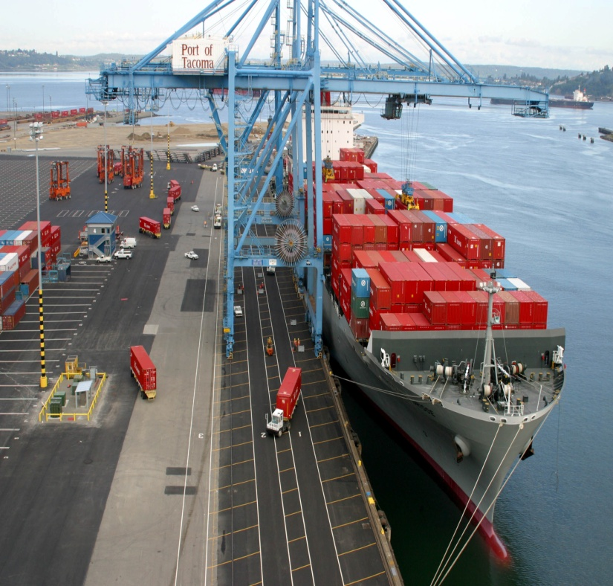
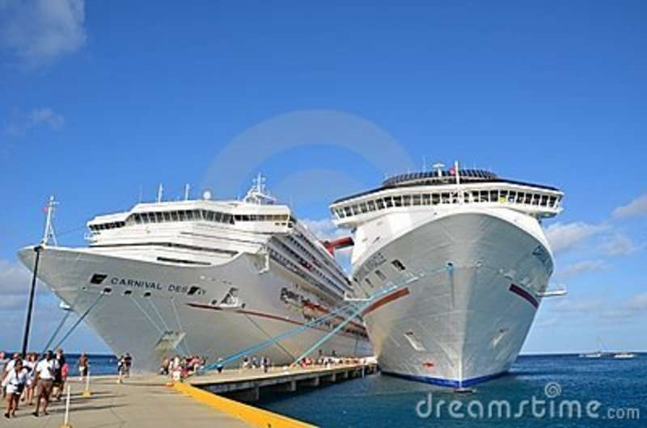
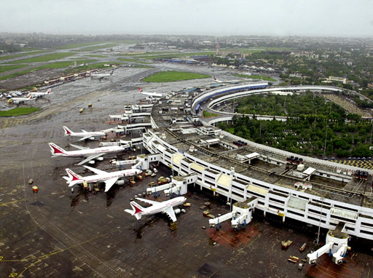
TRANSPORTATION
ENGINEERING
MECHANICAL ENGINEERING.
VADODARA INSTITUTE OF ENGINEERING.

Slide 4
INTRODUCTION
Transportation eng. Is the application of technological and scientific principle to the planning, functional design, operation, and management, of facilities for any mode of transportation in order to provide for the safe, rapid, comfortable, convenient, economical, environmentally compatible movement of people and goods.
Transportation eng. is practiced by policymakers, managers, planners, designers, engineers, operating and maintenance specialist and evaluators.

Slide 5
Transportation
The desire of people to move and their need for goods create the demand for transportation.
People ‘s preferences in terms of time, money and comfort, and convenience
.
A review of descriptions of the scope of various committees indicates that while facility planning and design continue to be the core of the transportation engineering field, such areas as operations planning, logistics, network analysis, financing, and policy analysis are also important to civil engineers, particularly to those working in highway and urban transportation.

Slide 6
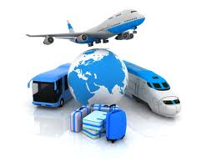
Types of transportation
Road ways
Rail ways
Air ways
Water ways

Slide 7
The efficiency of a transport mode
Speed
Safety
Adequacy
Frequency
Integration
Responsibilities
Comfort
Cheapness
Fuel efficiency
Employment generation
Travel time

Slide 8
Elements of modes of transportation
Mode of transportation | way | User | Vehicle | terminal
Road ways | Roads | pedestrian, Passenger , | Cycle, Bus, Truck,2w, 4w ,3w | Own residents, parking lots, employment location
Railways | Railway tracks | Passengers | Locomotives, Coaches, wagons | stations
Water ways | Shipping lines | Passengers | Ships, Boats | Harbors
Airways | Air routes | Passengers | Aircrafts | airports

Slide 9
Effect of well developed road network on the development of the country.
Well developed road network provides mass and rapid transportation of passengers and goods.
People of country make faster, safer and comfortable journey from one place to another.
Connectivity make exposure to urban and well developed area.
Industries and other employment sectors will grow due to availability of good employers.
Employers living standard increases by good absorbent.
The raw materials and finished goods can be transported easily, safely and faster.

Slide 10
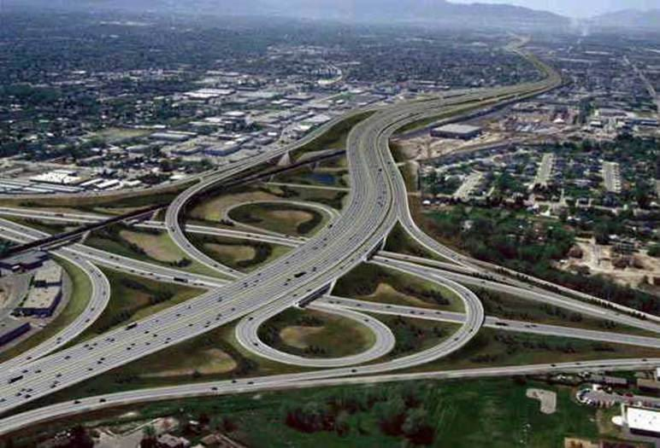
Road ways
All the roads do not cater for the same amount of a traffic volume or intensity.
The roads are classified as per traffic volume, tonnage of road transported, location and function.

Slide 11
Road development in India
For proper planning of road network in India a conference of a chief engineers was held at Nagpur in 1943.
One by one three 20 years road development programs for were planned for India
Nagpur road plans-1943-63.
Bombay road plans- 1961-81.
Lucknow road plans-1981-2001

Slide 12
Classification of roads according to position in national network of roads
National highways: They are main highways running through the length and breath of the nation connecting major ports foreign high ways, states & other local roads.
State high ways: They are arterials roads of a state connecting up with a national high ways of adjacent state & important cities with in state and district.
Major district road: They are the important roads with in the district serving areas of production and markets or with highways of a district.

Slide 13
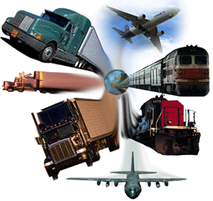
Other district roads : They are the roads serving rural area, market centers, taluka & other main roads.
Village roads: They are the roads connecting villages or group of villages with each other to the nearest road of a higher category.

Slide 14
Advantages of road ways
Road ways has maximum flexibility for travel with reference to route, direction, time and speed of travel.
Road ways serve feeder system of railways, airways and waterways.
For short distance travel road transport saves time.
Transportation to the interior parts , rural areas is convenient by the roads way.
Roadways provide door to door service .
Roadways are cheaper than rail ,water and air carrier.

Slide 15
Disadvantages of roadways
Passenger and goods carrying capacity is low compared to railways and waterways.
Speed is low compared to railways and airways. Suitable for small distance .
Maintenance of roadways should be regular otherwise comfort and safety is less.
Uncomfortable and uneconomical for long distance travel.
Number of accidents are high.

Slide 16
Railways
Railways can handle large number of passengers through coaches containing train movement on rails.
Railways can transport tonnes of goods perishable and non-perishable for long distance through closed and open wagons containing goods of train movement on rails.
Railways can be used by definite type of vehicles only it can carry out transportation on fixed routes between fixed stations.
There is no flexibility of route, stoppage or vehicles.

Slide 17
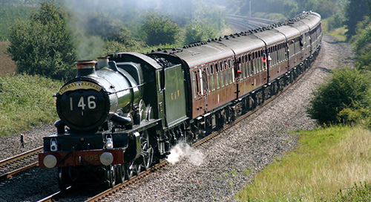

Slide 18
Advantages of railways
It facilitates long distance travel and transport of bulky goods which are not easily transported through motor vehicles.
It is a quick and more regular form of transport because it helps in the transportation of goods with speed and certainty.
It helps in the industrialization process of a country by easy transportation of coal and raw-materials at a cheaper rate.
It helps in the quick movement of goods from one place to another at the time of emergencies like famines and scarcity.
Railway is the safest form of transport. The chances of accidents and breakdown of railways are minimum as compared

Slide 19
Disadvantages of railways
The passengers and goods transported by trains can be loaded and unloaded from stations and yards only . They are dependent on roadways to reach to station or yard and to desired points .
Maintenance cost is high.
The trains run as per schedule. Their arrival and departure time is fix.
Definite vehicles can only run on railways.
Accident cause high loss.
Initial construction cost of railway stations , platforms, tracks, trains etc. is high.

Slide 20
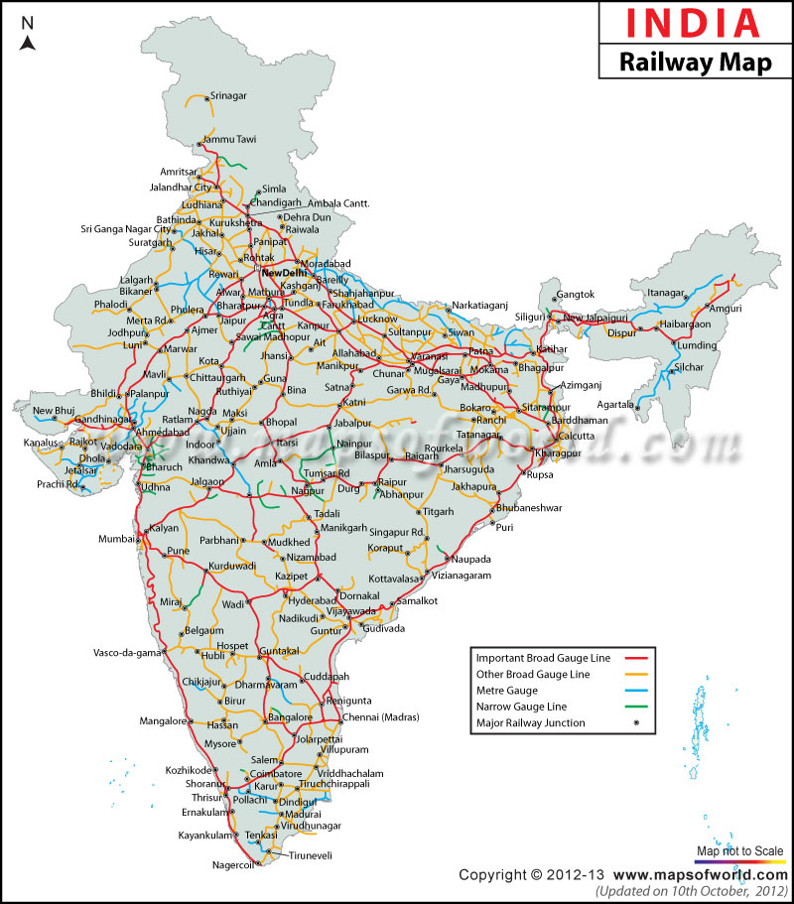

Slide 21
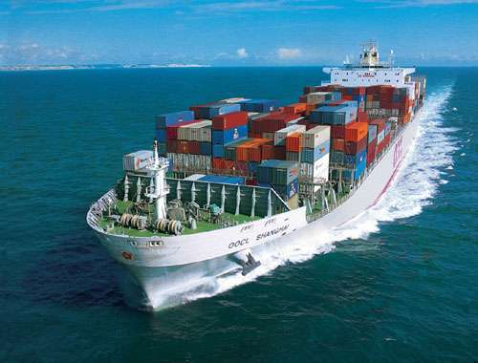
Water ways
A waterway is any navigable body of water. A shipping route consists of one or several waterways. Waterways can include rivers, lakes, seas, oceans, and canals. In order for a waterway to be navigable, it must meet several criteria:
The waterway must be deep enough to allow the draft depth of the vessels using it.
The waterway must be wide enough to allow passage for the beam width of the vessels using it.
The waterway must be free of barriers to navigation such as waterfalls and rapids, or have a way around them (such as canal locks and boat lifts.
The current of the waterway must be mild enough to allow vessels to make headway.
Vessels using waterways vary from small animal-drawn barges to immense ocean tankers and ocean liners, such as cruise ships.

Slide 22
Advantages of waterways
The waterways is the gift of nature. No need the of constructing tracks or path.
Cheapest mode of transportation.
It provides an efficient mean of defense for national security.
It possesses high load capacity. Large volume of goods , cargo , materials , can be transported goods.
It requires cheap motive power for its working . Tonnage of load of men and materials can be transported with small amount fuel consumption.

Slide 23
Disadvantages of waterways
It is slow. due to slow speed and circuitous routes travel time is more.
Ocean storms and hurricanes cause great loss of cargo.
It permits definite routes and limited connectivity.
It is useful along the particular routes only where water is available as a mode of transportation
It is depended on another modes of transportation. Road or rail network is required as a feeder for water transportation.

Slide 24
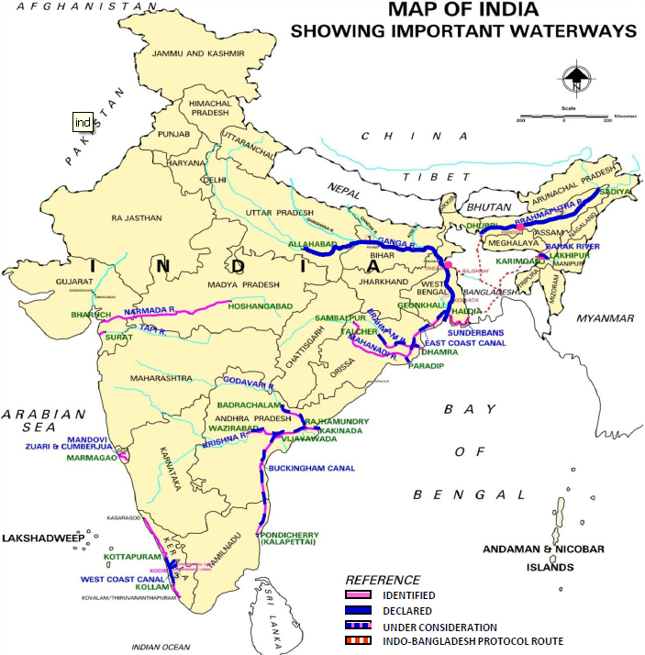

Slide 25
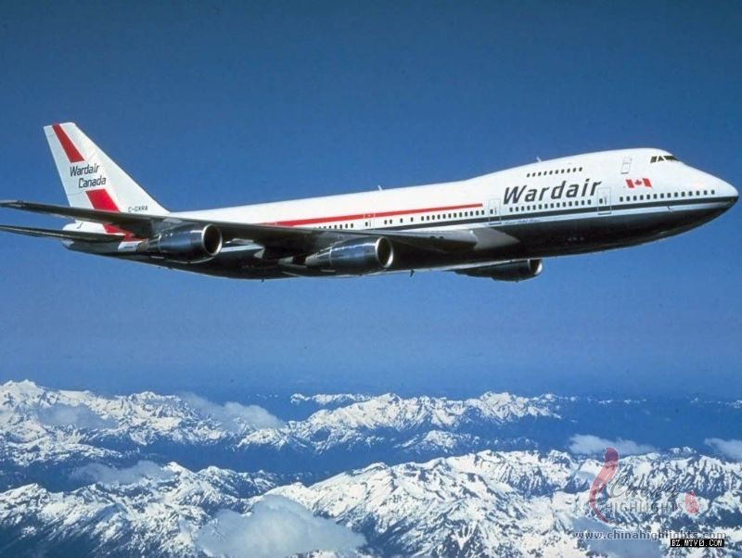
Air ways
Air transport is that the most up-to-date origin within the arena of transport system of any country. owing to the quick transit of products and folks via airways, the planet Cheap international air ticket tag economy has seen progress due to the actual fact that airways are ready to do everything in fast succession of your time.
Air ways are continuous faster but costlier ways of transportation.
Capacity to handle traffic is limited

Slide 26
Advantages of airways
High speed- Airways is that the fastest manner of transportation and so it’s got supersonic speed that guarantees that everything reaches its destination on time. For the urgent demand of products, there’s no substitute for air transport.
Fast Service- Quick service is another advantage of airways. It provides fast, sleek and well managed service.
No infrastructure need- It doesn’t require the development of rail tracks like railways. Thus, it’s a low cost mode of travel.
No physical barrier- Aircrafts will simply take folks on to their destinations regardless of any obstruction like seas, mountains or forests.
Quick Clearance- due to the short custom clearance, it saves time and one is prepared to fly in a very jiffy.

Slide 27
Disadvantages of airways
Most expensive. Travel cost is high.
Weather cond. Should be favorable for flight schedules.
Construction cost of airports and airplanes is high.
Fuel consumption is high.
Special training is to be given to the pilots, air hostesses and airport staff.
Maintenance cost of runways taxiways like airfield and airport components is high.
Due to accident loss is high.

Slide 29
Traffic engineering (transportation)

Slide 30
Traffic engineering
Traffic engineering is a branch of civil engineering that uses engineering techniques to achieve the safe and efficient movement of people and goods on roadways. It focuses mainly on research for safe and efficient traffic flow, such as road geometry, sidewalks and crosswalks, segregated cycle facilities, shared lane marking, traffic signs, road surface markings and traffic lights. Traffic engineering deals with the functional part of transportation system, except the infrastructures provided

Slide 31
Traffic engineering is closely associated with other disciplines:
Transport engineering
Pavement engineering
Bicycle transportation engineering
Highway engineering
Transportation planning
Urban planning
Human factors engineering.

Slide 32
Objectives of Traffic Engineer
While speed of travel is much to be desired, it is limited by transportation technology, human characteristics, and the need to provide safety.
Comfort and convenience are generic terms and mean different things to different people . Comfort involves the physical characteristics of vehicles and roadways , and is influenced by our perception of safety.
Convenience relates more to the ease with which trips are made and the ability of transport systems to accommodate all of our travel needs at appropriate times.

Slide 33
Economy is also relative. There is little in modern transportation systems that can be termed “cheap.”Highway and other transportation systems involve massive construction, maintenance, and operating expenditures, most of which are provided through general and user taxes and fees. Nevertheless, every engineer, regardless of discipline, is called upon to provide the best possible systems for the money.

Slide 34
Purpose of study of traffic volume:
Establish relative importance of any road.
Planning, designing and regulation of traffic.
Structural design of road.
Planning and design of new streets.
Establishment properties and schedules for traffic improvements.
Design of intersection and other control devices.

Slide 35
Traffic controlling devices :
Generally following four devices are provided on road to control the traffic:
Road signs
Markings
Signals
Traffic islands

Slide 36
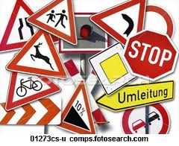
Road signs:
Roads signs are provided to warn, direct and guide the road users. They are in the form of symbols or inscription. They are mounted on fixed or portable supports and are placed on the side of roads.

Slide 37
Regulators or mandatory signs :
These signs are used to inform the road users, certain rules and regulations which has to notice for safe and free flow of traffic.
Some of the regulatory signs are:
Give way and stop signs:

Slide 38
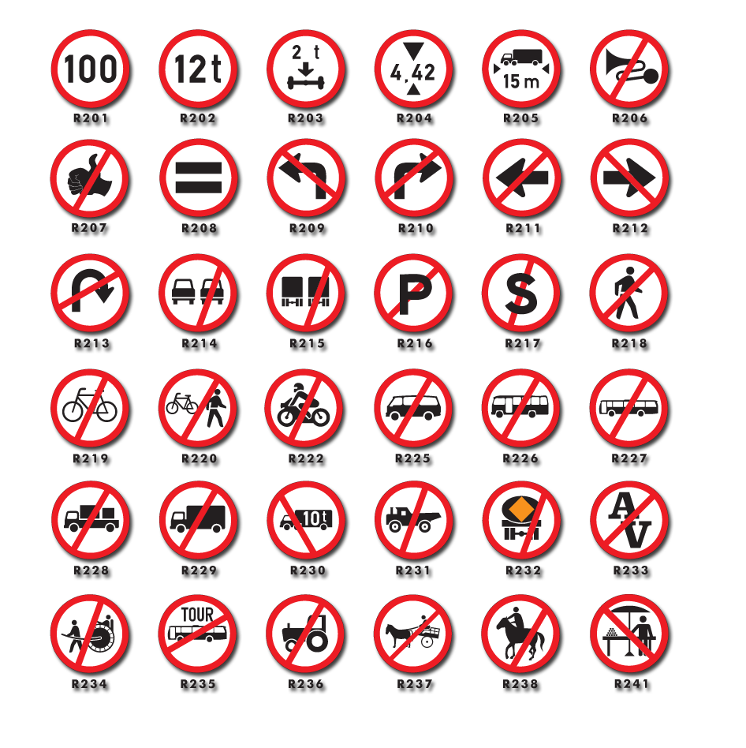
B. Prohibitory signs :

Slide 39
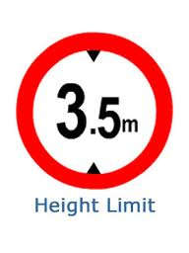
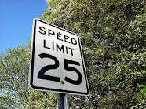
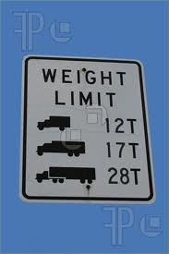
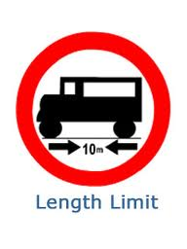
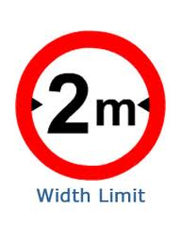
C. Speed limit and vehicle control signs:

Slide 40
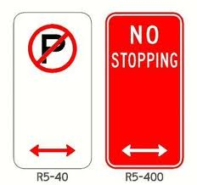
D. No parking, no stopping signs:

Slide 41
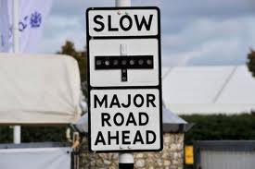
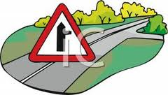
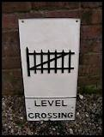
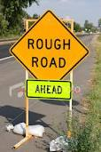
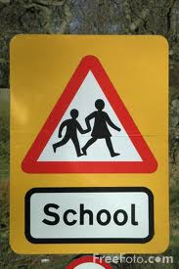
The various warnings signs used are:

Slide 42
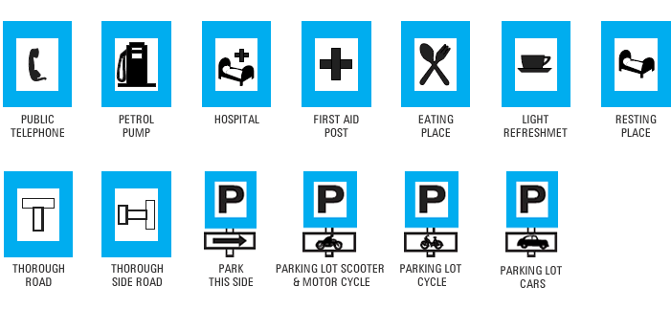
Informatory sign :

Slide 43
These are road signs used to guide road users along route, inform them about destination and distance ,and provide other information so as to make the road travel easier and safe.
An informatory sign usually consist of a rectangular board of specified size. In case of facility information signs, the size of rectangle shall be 800mm x 600mm for normal signs and the size of square shall be 400mm and 300mm.

Slide 44
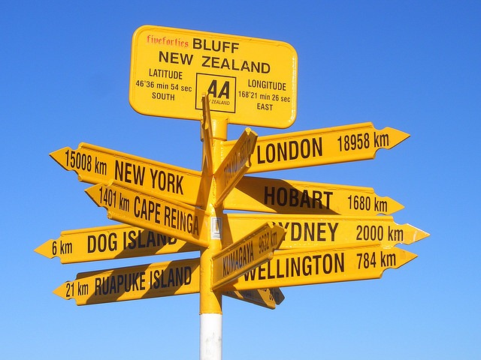

Slide 45
MARKINGS :
Traffic markings are the lines, patterns, words, symbols or reflectors applied to the carriage way, curves, sides of islands or to fixed objects near the road way.
The objects of the traffic marking is to warn , inform and guide the road users. They are made by using prints in contrast with colors and brightness on pavements or other background. Ordinary paints like oil paints are used for road markings.

Slide 46
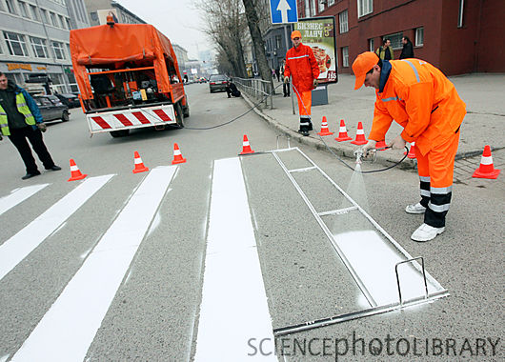

Slide 47
TRAFFIC CONTROL ELEMENTS

Slide 48
Components of Temporary Traffic Control Zones
Most temporary traffic control zones are divided into four areas:
Advance warning area,
Transition area
Activity area
Termination area.

Slide 49
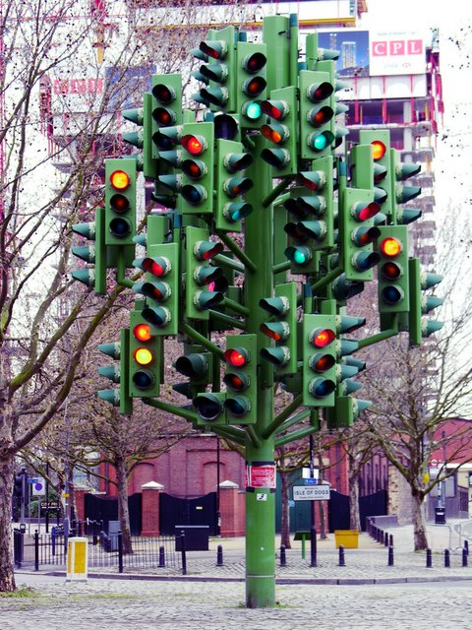
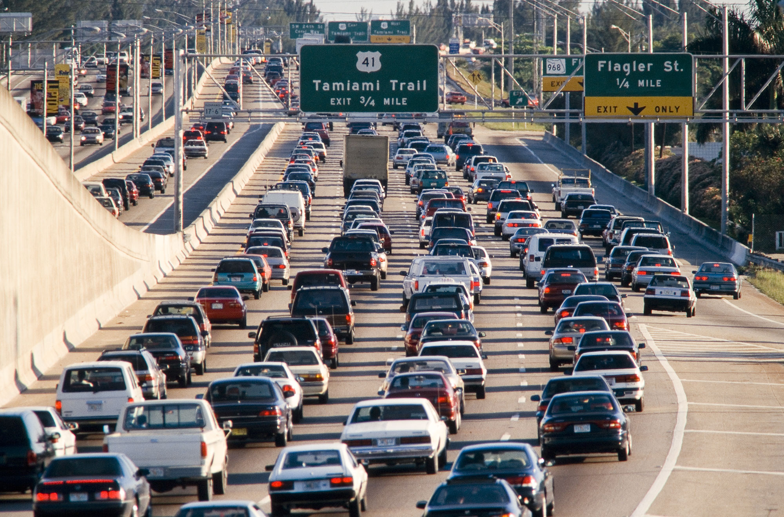

Slide 50
THANK YOU !!!!

